Slide 1
Getting Started with PHP

Slide 2
Credits
Some of the contents of this slide presentation have been referenced and reproduced from the textbook for this course, PHP Programming with MySQL (Second Edition) , Don Gosseling, Diana Kokoska, and Robert Easterbrooks, ©2011, Cengage Learning, All Rights Reserved. ISBN 978-0-5387-4584-0.
Thank you for some references to Kevin Skoglund, from PHP with MySQL Essential Training (2013), ©2017 LinkedIn Corporation.

Slide 3
LEARNING OBJECTIVES
Create basic PHP scripts
Create PHP code blocks
Understanding functions
Work with variables and constants
Study data types
Use expressions and operators

Slide 4
Creating Basic PHP Scripts
Embedded Language
Refers to code that is embedded within a Web page - HTML document
JavaScript and PHP can be embedded in Web pages
PHP code is typed directly into a Web page as a separate section
A Web page containing PHP code must be saved with an extension of .php to be processed by the scripting engine

Slide 5
Creating Basic PHP Scripts
Embedded Language
PHP code is never sent to a client’s Web browser; only the output of the processing is sent to the browser
The Web page generated from the PHP code, and HTML elements found within the PHP file, is returned to the client
.php is the default extension that most Web servers use to process PHP scripts

Slide 6
Creating PHP Code Blocks
Code Declaration Blocks
Separate sections on a Web page that are interpreted by the scripting engine
Four Types of PHP Code Declaration Blocks
Standard PHP script delimiters
The <script> element
Short PHP script delimiters
ASP-style script delimiters

Slide 7
Creating PHP Code Blocks
Standard PHP Script Delimiters
A delimiter is a character or sequence of characters used to mark the beginning and end of a code segment
The standard method of writing PHP code declaration blocks is to use the <?php and ?> script delimiters
The individual lines of code that make up a PHP script are called statements
PHP statements end with a semicolon ( ; )

Slide 8
Creating PHP Code Blocks
Standard PHP Script Delimiters
Syntax
<?php statements; ?>
The use of the standard delimiters is considered a Best Practice
Available on any web server that supports PHP

Slide 9
Creating PHP Code Blocks
Short PHP Script Delimiters
Syntax <? statements; ?>
Very poor practice
Your web site might not work
Short delimiters can be disabled in a Web server’s php.ini configuration file
A Web site ISP might not support short PHP script delimiters

Slide 10
Creating PHP Code Blocks
ASP-Style Script Delimiters
Syntax <% statements; %>
Very poor practice
Your web site might not work
Short delimiters can be enabled or disabled in a Web server’s php.ini configuration file
Short delimiters can be used in XHTML documents, but not in XML documents

Slide 11
Creating PHP Code Blocks
Using the <script> Element
Syntax <script language=”php”> statements; </script>
Very poor practice
The language attribute has been deprecated in HTML5

Slide 12
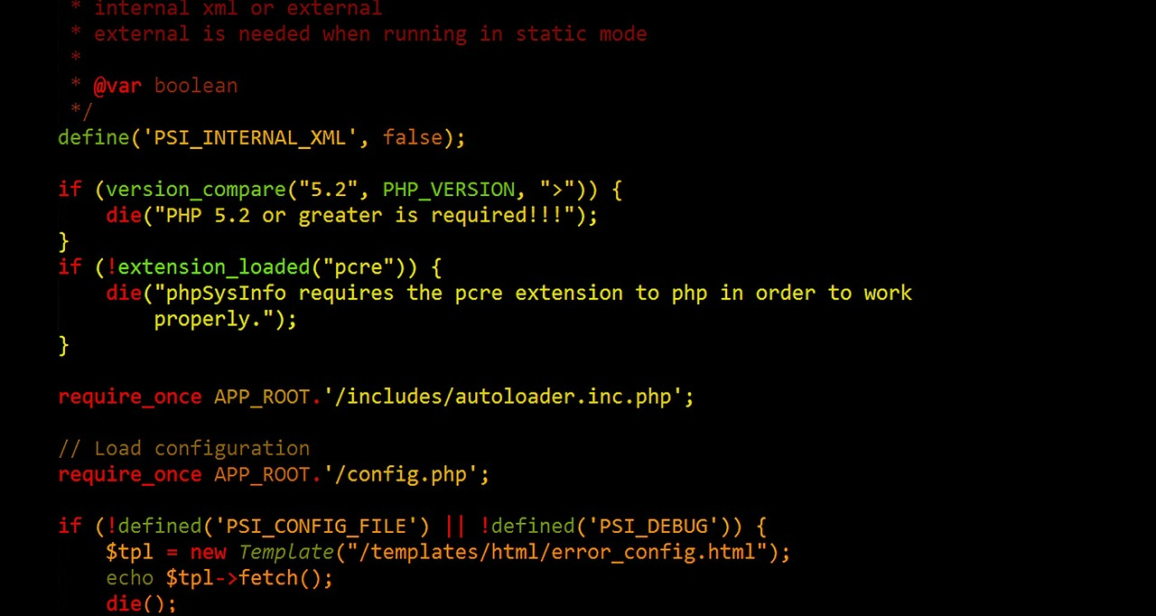
Creating PHP Code Blocks
Programming Exercise 02_01_01 – Step 1
Creating PHP Code Blocks

Slide 13
Creating PHP Code Blocks
Understanding Functions
PHP includes numerous built-in functions in its API
A function call is the function name followed by any data that the function needs
The data in parentheses following the function name are called arguments or actual parameters
Sending data to a called function is called passing arguments

Slide 14
Creating PHP Code Blocks
Understanding Functions
Functions may or may not generate, or return, some value
Some functions just go do a job and return nothing
Functions may accept multiple arguments, separated by commas
Sending data to a called function is called passing arguments

Slide 15
Creating PHP Code Blocks
Programming Exercise 02_01_01 – Step 2
Understanding Functions

Slide 16
Creating PHP Code Blocks
PHP Output
The PHP API provides two basic output functions
echo
print
Data may be passed to either as a literal string echo ”This is a literal string”;
Either may be used with function notation, but cannot take comma separated parameters echo(”Hello ”, ”world!”); // error
Concatenation operator: period ( . ) echo(”Hello ” . ”world!”); // ok

Slide 17
Creating PHP Code Blocks
PHP Output
The echo() statement does not return a value when used as a function
The print() statement does return a value when used as a function
Returns a value of 1 if successful, 0 if not successful
Neither statement outputs a line feed at the end
HTML tags, such as <br>, may be embedded in the string literal an used as formatting
Data types other than string, and math may be used as arguments

Slide 18
Creating PHP Code Blocks
Programming Exercise 02_01_01 – Step 3
PHP Output

Slide 19
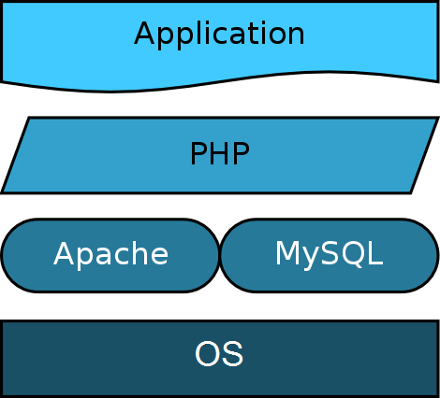
Creating PHP Code Blocks
The Operational Trail
https://www.youtube.com/watch?v=dMxNzS51nAU

Slide 20
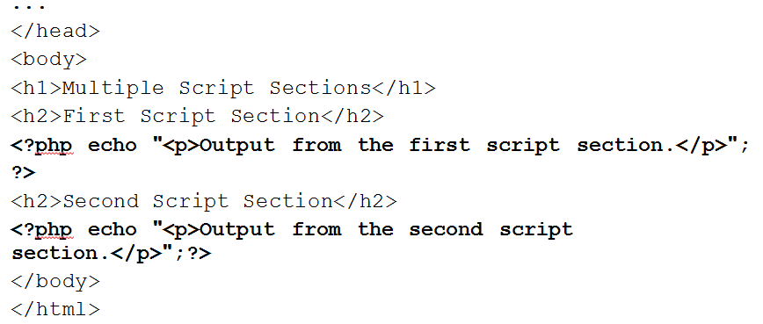
Creating PHP Code Blocks
Creating Multiple Code Declaration Blocks
You can include an unlimited number of PHP script sections in an HTML document
You must include a separate code declaration block for each section

Slide 21
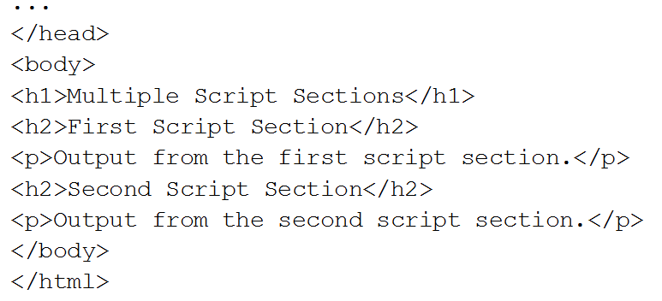
Creating PHP Code Blocks
Creating Multiple Code Declaration Blocks
PHP code declaration blocks execute on a Web server before the page is sent to the client

Slide 22
Creating PHP Code Blocks
Programming Exercise 02_01_01 – Step 4
Creating Multiple Code Declaration Blocks

Slide 23
Creating PHP Code Blocks
Case Sensitivity in PHP
PHP is unlike most other programming languages regarding case
Keywords are not case sensitive
Function names are not case sensitive
Variable names are case sensitive
Best Practices: treat PHP like any other language
Keywords in lower case
Variables and function names camelCased

Slide 24
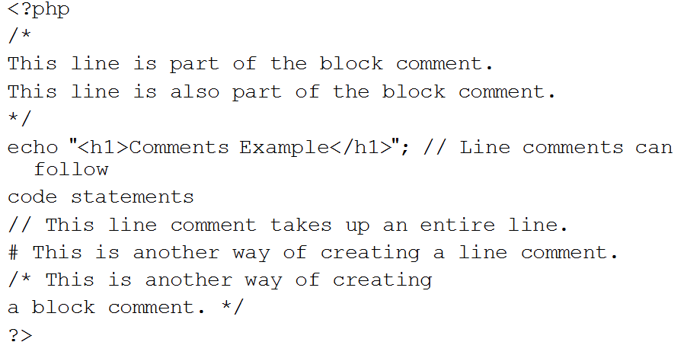
Creating PHP Code Blocks
Adding Comments to a PHP Script
Line comments
Use typical // or Python-style #
Block comments
Use typical pairs /* and */

Slide 25
Creating PHP Code Blocks
Programming Exercise 02_01_01
Go back to your code and document!!

Slide 26
Work with Variables and Constants
Variables
The values stored in computer memory are called variables
Variables may be considered named memory locations
The values, or data, contained in variables are classified into categories known as data types
The name you assign to a variable is called an identifier

Slide 27
Work with Variables and Constants
Naming Variables
Cannot be PHP reserved words (keywords)
Identifiers must begin with a dollar sign ( $ )
Identifiers may contain uppercase and lowercase letters, numbers, or underscores ( _ )
The first character after the dollar sign must be a letter or underscore
Best Practice: stay away from underscores after the $ sign: special meaning to PHP (later)
Identifiers cannot contain spaces
Identifiers are case-sensitive

Slide 28
Work with Variables and Constants
Declaring and Initializing Variables
Specifying and creating a variable name is called declaring the variable
Assigning a first value to a variable is called initializing the variable
In PHP, you must declare and initialize a variable in the same statement
It is created the moment a value is first assigned to it $variableName = value;

Slide 29
Work with Variables and Constants
Displaying Variables
Use the echo statement, pass the variable name without enclosing it in quotation marks $votingAge = 18; echo $votingAge;
For combining text strings and variables, use the echo statement with arguments separated by commas echo ”<p>The legal voting age is ”, $votingAge, ”.</p>”;

Slide 30
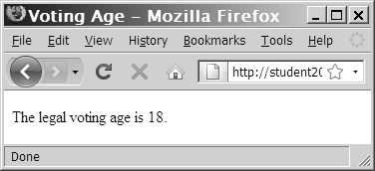
Work with Variables and Constants
Displaying Variables
For combining text strings and variables, use the echo statement with concatenated arguments echo ”<p>The legal voting age is ”. $votingAge . ”.</p>”;

Slide 31
Work with Variables and Constants
Displaying Variables Enclosed in Strings
Depends if string is delimited by double or single quotes
Double quotes expand the variable and print its value echo ”The voting age is $votingAge.” // output is The voting age is 18.
Use curly braces to expand and to delineate the variable from anything next to it echo ”The voting age is {$votingAge}hi.” // output is The voting age is 18hi.
Single quotes print the variable name echo ’The voting age is $votingAge.’ // output is The voting age is $votingAge.

Slide 32
Work with Variables and Constants
Programming Exercise 02_01_01 – Step 5
Using Variables

Slide 33
Work with Variables and Constants
Constants
A constant contains information that does not change during the course of program execution
Constant names do not begin with a dollar sign ( $ )
Constant names use all uppercase letters
Use the define() function to create a constant define(”CONSTANT_NAME”, value);
The value you pass to the define() function can be a text string, number, or Boolean value
Constants will not expand in double quoted strings

Slide 34
Work with Variables and Constants
Programming Exercise 02_01_01 – Step 6
Defining Constants

Slide 35
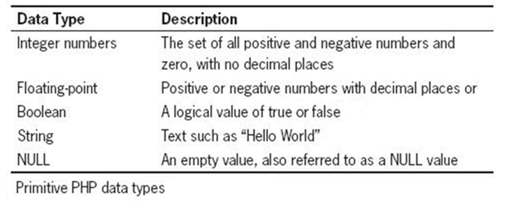
Working with Data Types
Data Types
A data type is the specific category of information that a variable contains
Data types that can be assigned only a single value are called primitive types

Slide 36
Working with Data Types
Complex PHP Data Types
A resource data type
A special variable that holds a reference to an external resource such as a database or XML file (later)
Reference or composite data types
Contain multiple values or complex types of information
Two PHP reference data types: arrays and objects

Slide 37
Working with Data Types
Typing in Programming Languages
Strongly typed programming languages require you to declare the data types of variables
Static or strong typing refers to data types that do not change after they have been declared
Loosely typed programming languages do not require you to declare the data types of variables
Dynamic or loose typing refers to data types that can change after they have been declared
PHP is a loosely typed programming language

Slide 38
Working with Data Types
Numeric Data Types
An integer is a positive or negative whole number and 0 with no decimal places (-250, 2, 100, 10,000, 0)
A floating-point number is a number that contains decimal places, or that is written in exponential notation (-6.16, 3.17, 2.7541)
Exponential notation, or scientific notation, is a shortened format for writing very large numbers or numbers with many decimal places (2.0e11)

Slide 39
Working with Data Types
Boolean Data Types
A Boolean value is a value of true or false
Not case sensitive, TRUE and FALSE are valid
Can be used for flow of control or comparisons
Can be used to compare data
In PHP, echoing Boolean values may convert them to strings: ”1” for true or ”0” for false echo true; // == 1 echo false; // == 0 or empty
The is_bool() function is true ( ”1” ) if a variable is a Boolean echo is_bool($happy);

Slide 40
Working with Data Types
null and Empty
null is a term for not having a value
It is not equivalent to zero ( 0 ) or the empty string: ””
Not automatically set when using an undefined variable
It is often a good practice to initialize variables to null $customerName = null;
The is_null() function is true if a variable is null echo is_null($customerName);
The empty() function is true if a variable is empty // ””, 0, 0.0, ”0”, false, array()

Slide 41
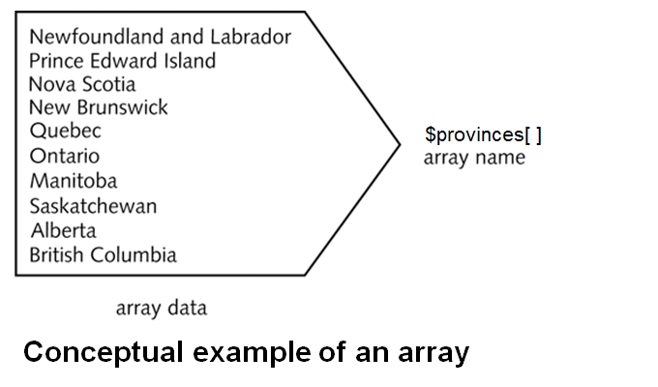
Working with Data Types
Arrays
An array contains a set of data represented by a single variable name

Slide 42
Working with Data Types
Arrays
An element refers to each piece of data that is stored within an array
An index, or subscript, is an element’s numeric position within the array
By default, indexes begin with the number zero (0)
An element is referenced by enclosing its index in brackets at the end of the array name $provinces[1]

Slide 43
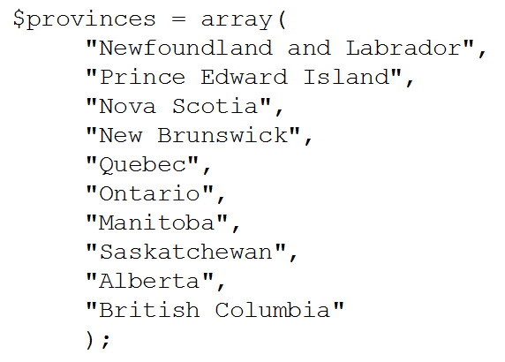
Working with Data Types
Declaring and Initializing Arrays
The array() constructor syntax is $arrayName = array(values);

Slide 44
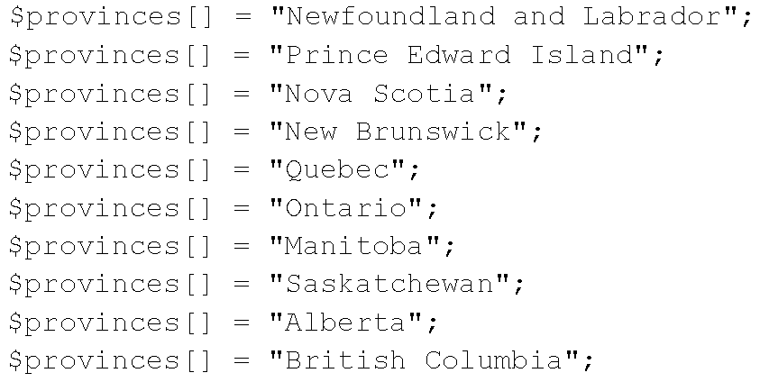
Working with Data Types
Declaring and Initializing Arrays
Array name and brackets syntax is $arrayName[]

Slide 45
Working with Data Types
Array Functions
Use the count()function to find the total number of elements in an array echo count($provinces);
Use the print_r()function to display the index and value of each element in an array print_r($provinces);
Use the var_dump() function to display the index, value, data type, and number of characters in the value var_dump($provinces);

Slide 46
Working with Data Types
Programming Exercise 02_01_01 – Step 7
Arrays

Slide 47
Using Expressions and Operators
Building Expressions
An expression is a literal value or variable or combination of them that can be evaluated by the PHP scripting engine to produce a result
Operands are the variables and literals contained in an expression
A literal is a static value such as a literal string or a number: “hello” or 15 or 3.14159
Operators are symbols ( + ) or ( * ) that are used in expressions to manipulate operands

Slide 48
Using Expressions and Operators
Operators
A binary operator requires an operand before and after the operator $myNumber + 100;
A unary operator requires a single operand either before or after the operator ++$i $i++ --$j $j-- !$happy

Slide 49
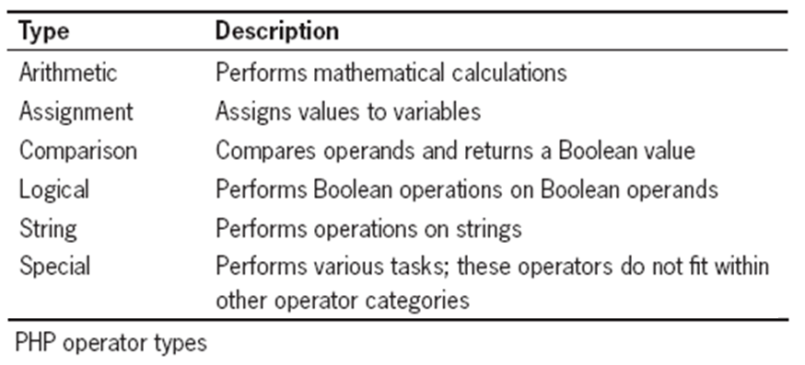
Using Expressions and Operators
Operators

Slide 50
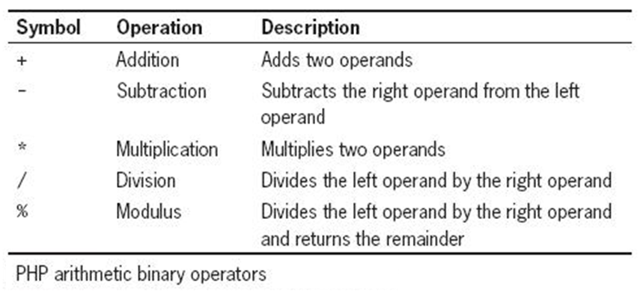
Using Expressions and Operators
Arithmetic Binary Operators
Used in PHP to perform mathematical calculations

Slide 51
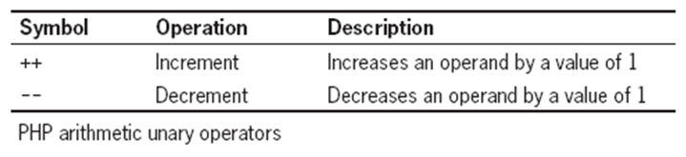
Using Expressions and Operators
Arithmetic Unary Operators
The increment (++) and decrement (--) unary operators can be used as prefix or postfix operators
A prefix operator is placed before a variable
A postfix operator is placed after a variable

Slide 52
Using Expressions and Operators
Programming Exercise 02_01_01 – Step 8
Arithmetic Operators

Slide 53
Using Expressions and Operators
Assignment Operators
Used for assigning a value to a variable: $myFavoriteSuperHero = "Superman";
Compound assignment operators
Perform mathematical calculations on an expression
Then assign a new value to the operand to the left of the assignment operator

Slide 54
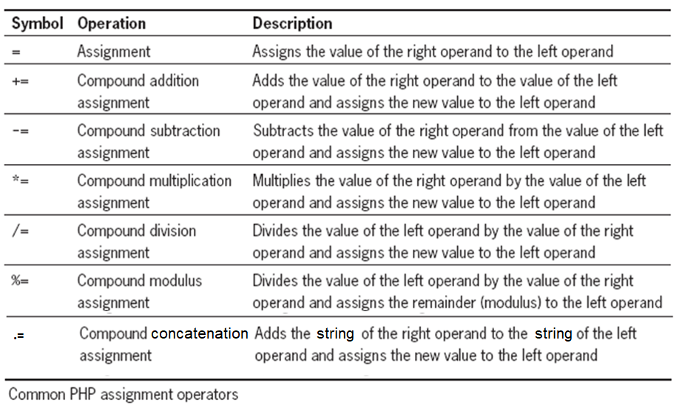
Using Expressions and Operators
Assignment Operators

Slide 55
Using Expressions and Operators
Programming Exercise 02_01_01 – Step 9
Assignment Operators

Slide 56
Using Expressions and Operators
Comparison or Relational Operators
Used to compare two operands and determine how one operand compares or relates to another
A Boolean value of TRUE or FALSE is returned after the expression is evaluated
The comparison operator ( == ) compares values, whereas the assignment operator ( = ) assigns values
Comparison operators are used with conditional statements and iteration (looping) statements

Slide 57
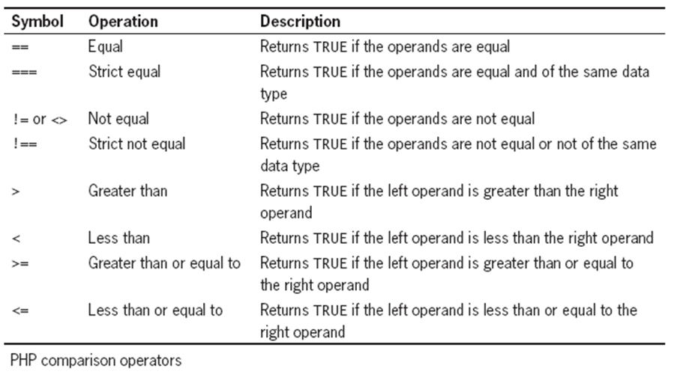
Using Expressions and Operators
Comparison or Relational Operators

Slide 58
Using Expressions and Operators
Conditional Operator
The conditional operator executes one of two expressions, based on the results of a conditional expression
Syntax conditional expression ? expression1 : expression2;
If the conditional expression evaluates to TRUE, expression1 executes
If the conditional expression evaluates to FALSE, expression2 executes

Slide 59
Using Expressions and Operators
Programming Exercise 02_01_01 – Step 10
Comparison and Conditional Operators

Slide 60
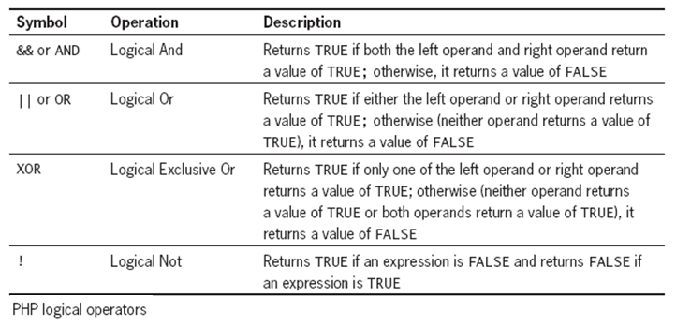
Using Expressions and Operators
Logical Operators
Used for comparing two Boolean operands for equality
A Boolean value of TRUE or FALSE is returned after two operands are compared

Slide 61
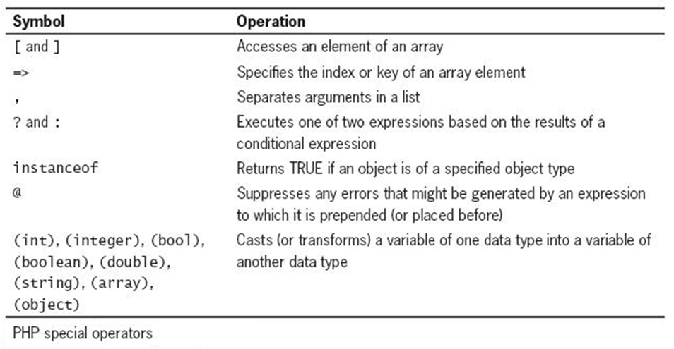
Using Expressions and Operators
Special Operators

Slide 62
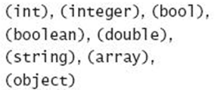
Using Expressions and Operators
Type Casting
Casting or type casting converts a value of one data type into a value of another data type
Syntax $newVariable = (newType) $oldVariable;
newType refers to the type-casting operator representing the type to which you want to cast the value

Slide 63
Using Expressions and Operators
The gettype() Function
Syntax echo gettype($myVar);
Depending on the data type, returns one of the following strings
Boolean
Integer
Double
String
Array
Object
Resource
NULL
Unknown type

